Slide 1


Automaton Theories of Human Sentence Comprehension
John T. Hale (2014)
발제자: 박기효
2020. 02. 29.

Slide 2
Chapter 6. Experience as a Control Strategy for Incremental Parsing

Slide 3
Introduction
- The heuristics from the Pereira-Shiber fomalization of Garden-Path Theory
→ Compatible with lots of human processing, especially on the garden-path sentences.
But when applied more widely, to free text, their performance is disappointing.
- Franz (1996): No set of fixed heuristic pricinples performs well enough to be taken as a
psycholinguistic law, or to help much in a natural-language computer
system.
- It appeared that quite a lot of rules woud be needed to approximate the syntactic
attachment preferenes of even a monolingual speaker.
→ Alternative views: To theorize not the attachment preferences themselves, but rather
their relationship to experiences that a hearer in the relevant
language community would have (Mitchell et al, 1995; Jurafsky
1996)

Slide 4
Introduction
- Two examples of how learning might fit into incremental parsing
1. Reinforcement Learning
- A new model whose syntactic attachment preferences do in fact change with
experiences.
2. Batch approach
- Experience with a text corpus is summarized in large table.
- Alleviate the restriction to single-path parsing to show how the appearance of
parallel processing might emerge as a result of experience.

Slide 5
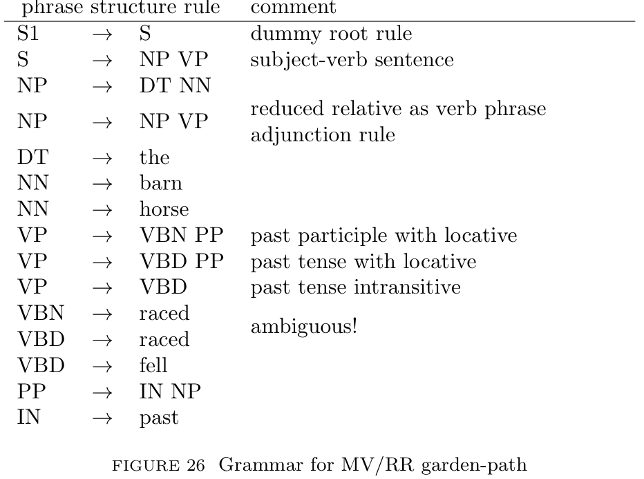
Reinforcement-learning
- Figure 26
- Considering each of the rules of this grammar, we adopt the parsing strategy, i.e., the
left-corner parsing.
→ They are announced as soon as the first daughter symbols has been found bottom-up.
- In these automaton models, ambiguity becomes nondeterminism about selecting the
next parser ation.

Slide 6
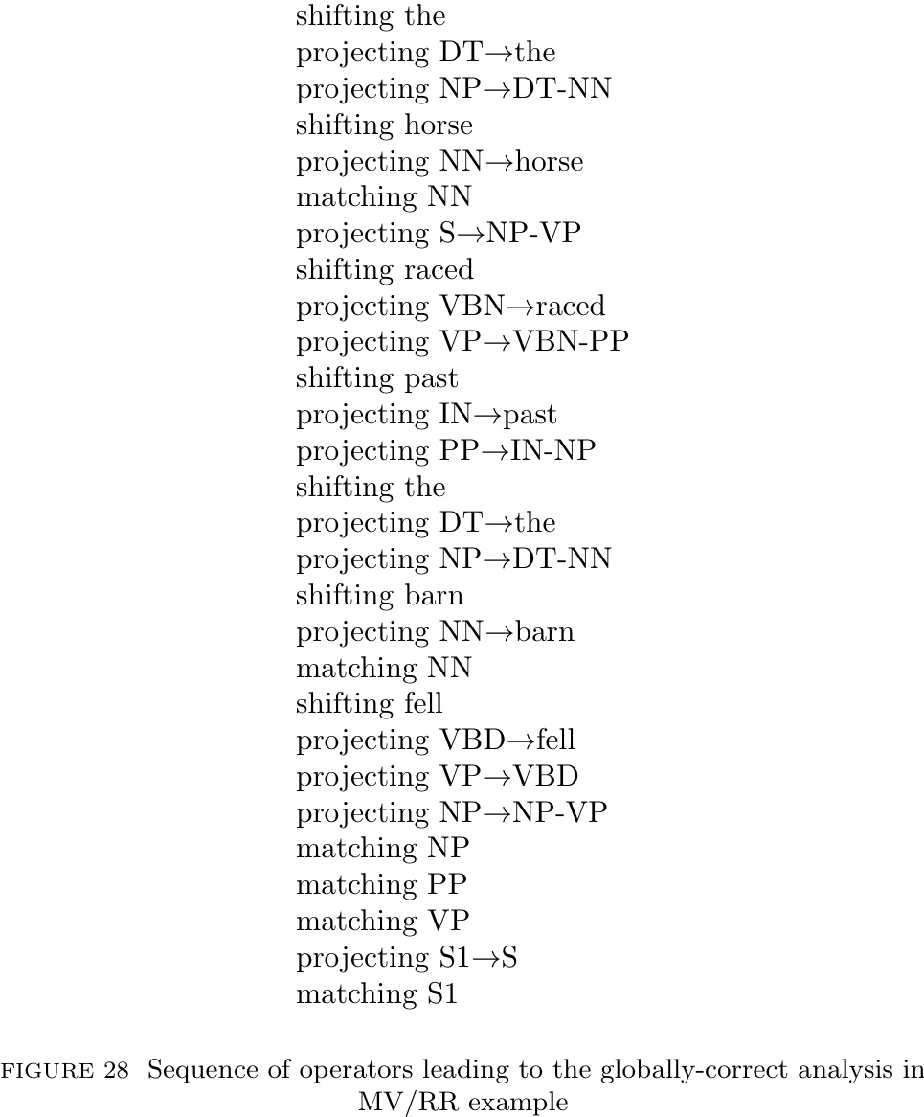
Reinforcement-learning
- The correct sequence of actions is congruous with a traversal of
the globally-correct tree. (Fig. 28)
- Sine qua non: The odds of hitting upon exactly this sequence are
not good.

Slide 7
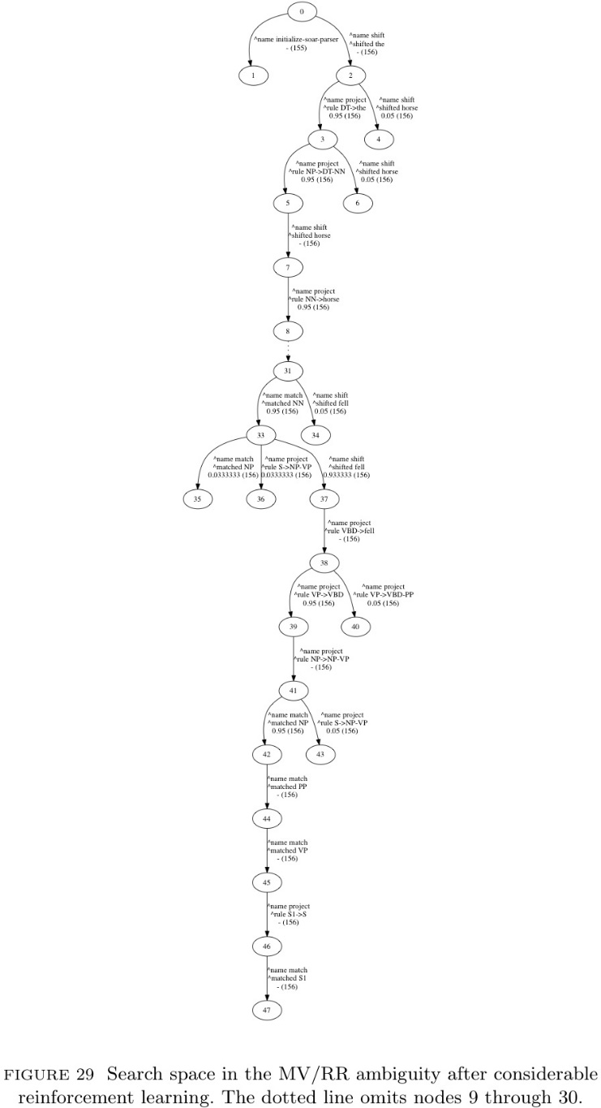
Reinforcement-learning
- These bad odds reflect the preponderance of choice points (Fig. 29)
- A Soar model destructively updates the contents of working
memory, maintain exactly one stack of sought/found grammar
symbols and basing its decisions on whatever knowledge is
available, but there is no knowledge available so Soar is indifferent.

Slide 8
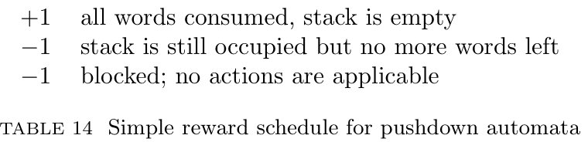
Reinforcement-learning
- We can define a schedule of rewards and punishments for Soar’s built-in RL facility
(Tab. 14)
- Positive numbers: reward ↔ negative ones: punishments
- This feedback is meted out only at the end, but via Soar’s built-in RL facilities they
come to tune the choice of all operators seleted throughout the analysis process.
- At the end of a failed run, the model goes back to the beginning of the sentence and
tries again.
- Each choicepoint is a tie impasse whose resolution gets rcecorded in a chunck, which
express preferences.

Slide 9
Reinforcement-learning
- In this particular model, these chunks have a numerical strength parameter: Q-learning
- Q-learning iteratively estimates the expected reward that would come from taking an
action in a state.
- Since reward in this formulation comes only at the end, the model learns backwards:
first it straightenes out the the last choice point, then the next-to-last, the next-to-next-
to-last, et cetra.
- Although the model does learn, when extended to larger grammars, this method seems
unrealisitically slow probably due to the over-simple notion of feedback (just) at the end.
- It remains an open research question how best to formulate a notion of feedback that
leads to preferring one syntactic structure over another.

Slide 10
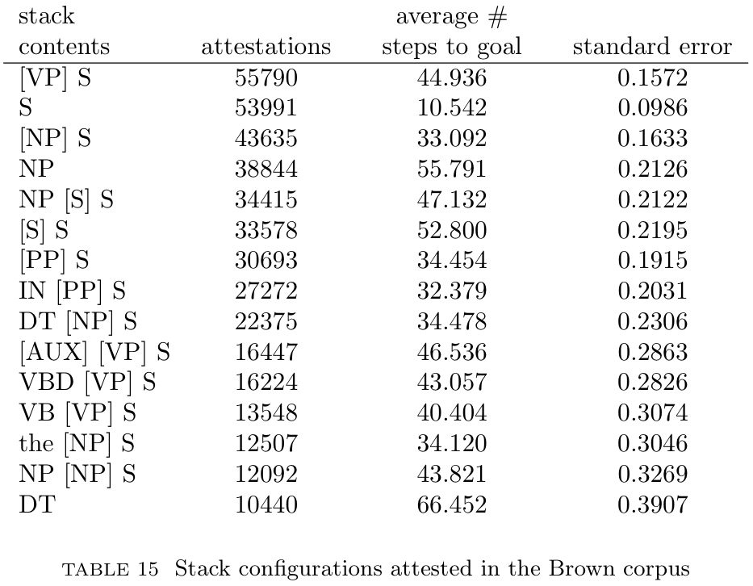
Informed Serach with a Distance Estimate
- There’s a distance factor scaling the +1s and -1s at the end of candidate state
trajectories.
- If any finished state is acceptable, then a rational parser would move along the path whose estimated distance to a finished state is shortest.
Informed Serach
- An estimate of the distance to the goal informs a searcher
about which state to choose.
- Estimate: In parsing, ditances cannot be known with
certainty. → CORPUS (Tab. 15)
- Rather than iteratively estimating expected reward,
by acquiring tables like tab. 15, estimate can be
looked-up and associated with search states.

Slide 11
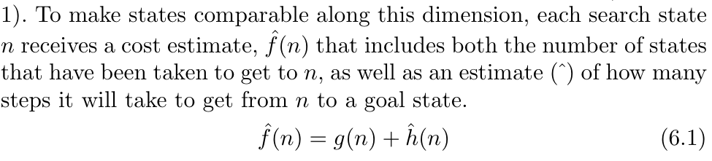
The A* Formulation and Multipath Parsing
- In a sigle-path parser like the Soar models, it ultimately results in one operator being
applied.
- A multipath arrangement maintains the fringe of the serach tree, the set of parser
states that have been reached but whose successors have not yet been explored.
- A parser state that is farther along in the sentence will presumably have a smaller
heuristic distance estimate than a state that is less far along.
- A* algorithm offers a gurantee that the shortest path will be found in the fewest number
of steps.
□ ‘Admissibility’ that amounts to a promise never to underestimate the true distance.

Slide 12
The A* Formulation and Multipath Parsing
- Two interesting points of the A* Formulation
1. A shorter, simpler analysis being preferable.
2. It saves the cognitive modeler from having to separately specify the exact number of
paths that are pursued simultaneously in multipath parsing, i.e. to be determined
indirectly by the heuristic.
- If the heuristic is very “sharp”, then A* will behave more like depth-first serach (single-
path)
- On the other hand, if the heuristic is not so sharp, then A* will degenerate into breadth-
first serach (multi-path)

Slide 13
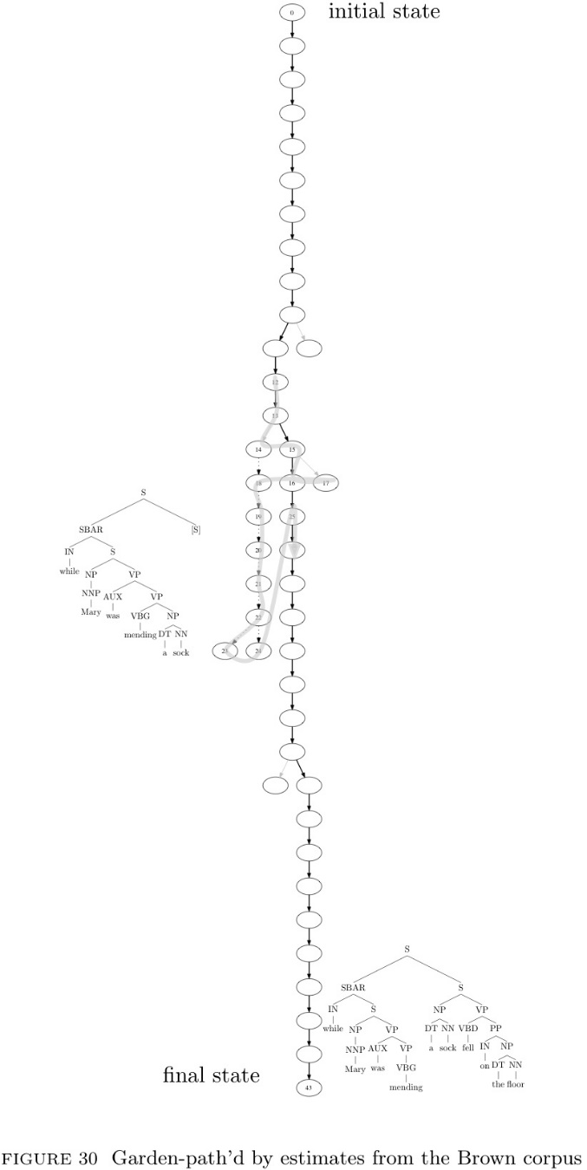
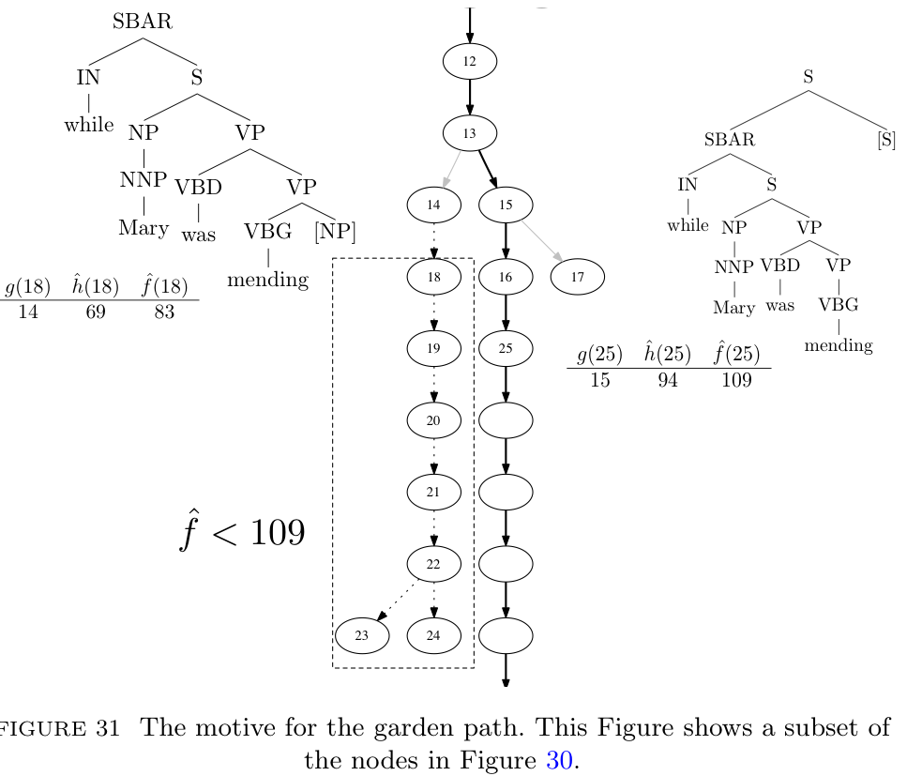
Informed Serach Emulating Late Closure
“While Mary was mending a sock fell on the floor”
- Figure 30 (right next) shows the entire serach tree.
□ Heavy lines: glollay-correct pathway
□ Doted lines: the garden-path analysis
- In Figure 31, the essential point is that prior experience makes
the garden-path more attractive.

Slide 14
Informed Serach and the Appearance of Parallel Processing
- In cases where the heuristic is not so sure what to do, exploration begins to look more
and more like breadth-first search.
- Where differenced in hat f are small, informed serach can derive a kind of parallel
processing even though it is extending just one state at a time.
- It does so by flitting back and both between different analyses.
- This is one way that informed search could explain the absence of garden path effects in
sentences where fixed heuristics would imply that they should exist.

Slide 15
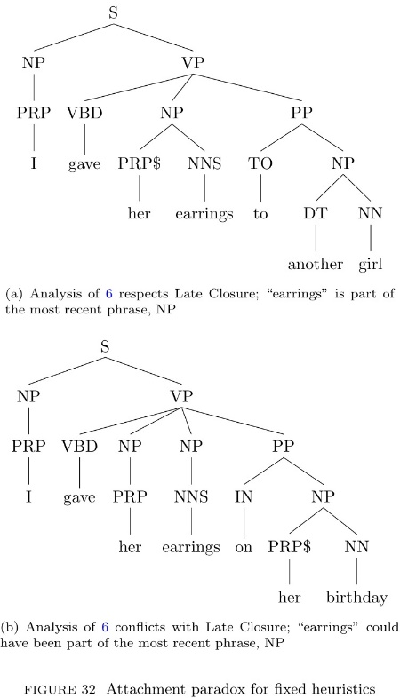
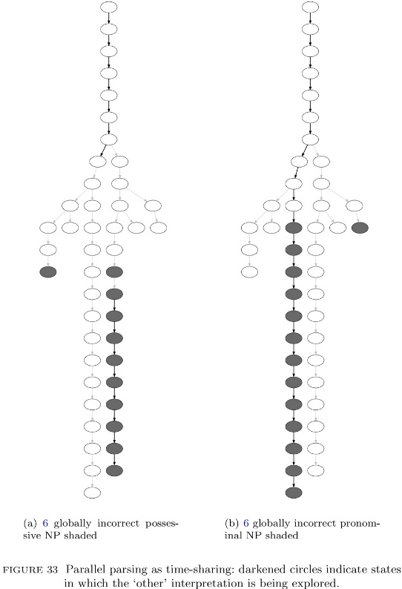
Informed Serach and the Appearance of Parallel Processing
- Figrue 32.
→ No matter which was fixed preferences are formulated, they derive a prediction of
garden-pathing on half the items.
- One way out of the dilemma is to say that both analysises are built in parallel (Fig. 33)
- This interleaving mimics (apparent) parallel parsing by switching back and forth between
alternative analysis paths.

Slide 16
감사합니다!

